Slide 1
PERCENTAGE
Successive percentage change, Product constancy method.

Slide 2

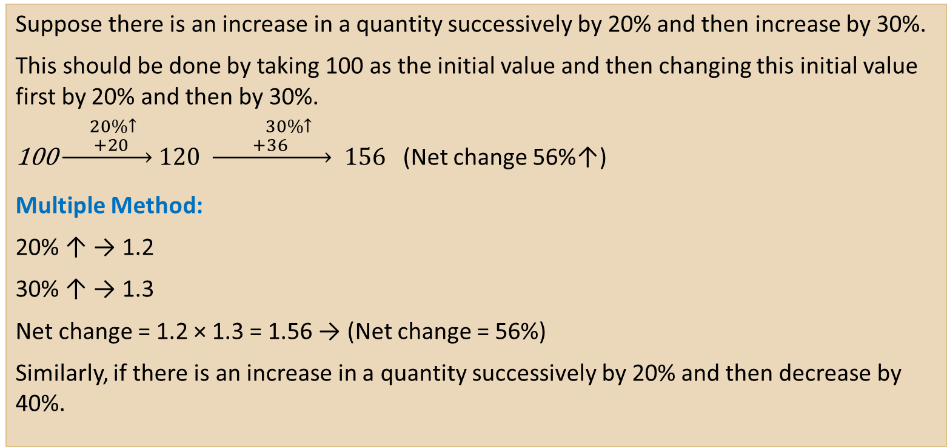
SUCCESSIVE PERCENTAGE CHANGE
Suppose there is an increase in a quantity successively by 20% and then increase by 30%.
This should be done by taking 100 as the initial value and then changing this initial value first by 20% and then by 30%.
$\underset{→}{ \begin{aligned}20\%↑ \\ +20 \end{aligned}} 120 \underset{→}{ \begin{aligned}30\%↑ \\ +36 \end{aligned}} 156$ (Net change 56%↑)
Multiple Method:
20% ↑ → 1.2
30% ↑ → 1.3
Net change = 1.2 × 1.3 = 1.56 → (Net change = 56%)
Similarly, if there is an increase in a quantity successively by 20% and then decrease by 40%.

Slide 3
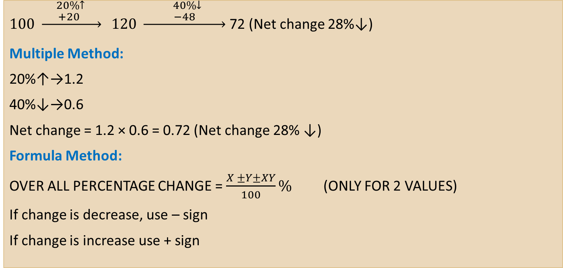
SUCCESSIVE PERCENTAGE CHANGE
$100 \underset{→}{\begin{aligned} 20\%↑ \\ +20 \end{aligned}} 120 \underset{→}{\begin{aligned} 40\%↓ \\ −48\end{aligned}}$ 72 (Net change 28%↓)
Multiple Method:
20%↑→1.2
40%↓→0.6
Net change = 1.2 × 0.6 = 0.72 (Net change 28% ↓)
Formula Method:
OVER ALL PERCENTAGE CHANGE = $\frac{X ±Y±XY}{100}\%$ (ONLY FOR 2 VALUES)
If change is decrease, use – sign
If change is increase use + sign

Slide 4
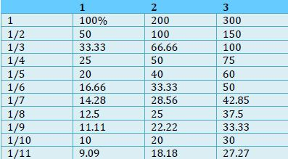

PERCENTAGE – RATIO EQUIVALENCE
The essence of percentage−ratio equivalence lies in the fact that most of the percentage calculations like 25%, 37.5%, 33.33%, etc., hover around some particular ratios only.
Ex: Find 37.5% of 120?
Solution:
$\frac{37.5}{100}×120=\frac{37.5}{5}×6$
7.5 $×$ 6 = 45.
Shortcut :
=> $\frac{3}{8}×120$ = 3 $×$ 15 = 45.

Slide 5
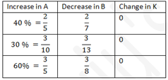
PRODUCT CONSTANCY METHOD
In a number of topics and concepts, we encounter the relationship where the product of two quantities equals the third quantity.
For example,
Speed × Time = Distance
Price × Consumption = Expenditure
By generalizing product stability ratio, then it can be as,
A × B = P.
Now, if A is increased by a certain percentage, then B is required to be decreased by certain percentage so that the product (P) remains stable.

Slide 6
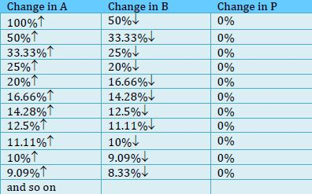

PRODUCT CONSTANCY METHOD
Example:
If there is an increase A by 25% and P has to be constant, then B is required to be decreased by %?
$100 \underset{→}{\begin{aligned} 25\%↑ \\ +25\end{aligned}} 125 \underset{→}{ ? }$ 100
$$Percentage Change= \frac{25}{125}×100=20\%$$
$100 \underset{→}{\begin{aligned} 25\%↑ \\ +25\end{aligned}} 125 \underset{→}{\begin{aligned} 20\%↓ \\ −25 \\ \end{aligned}}$ 100

Slide 7

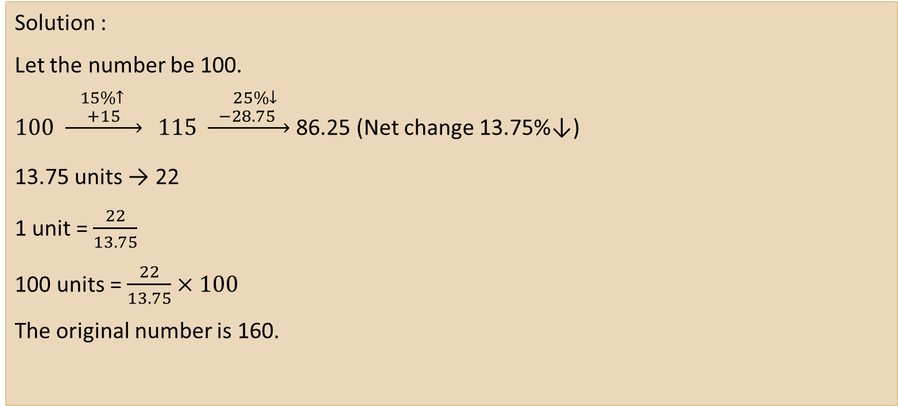
Problems A number is increased by 15% and then decreased by 25% and the number becomes 22 less than the original number. The original number is
Solution :
Let the number be 100.
$100 \underset{→}{\begin{aligned} 15\%↑ \\ +15\end{aligned}} 115 \underset{→}{\begin{aligned} 25\%↓ \\ −28.75 \end{aligned}}$ 86.25 (Net change 13.75%↓)
13.75 units → 22
1 unit = $\frac{22}{13.75}$
100 units = $\frac{22}{13.75}×100$
The original number is 160.

Slide 8
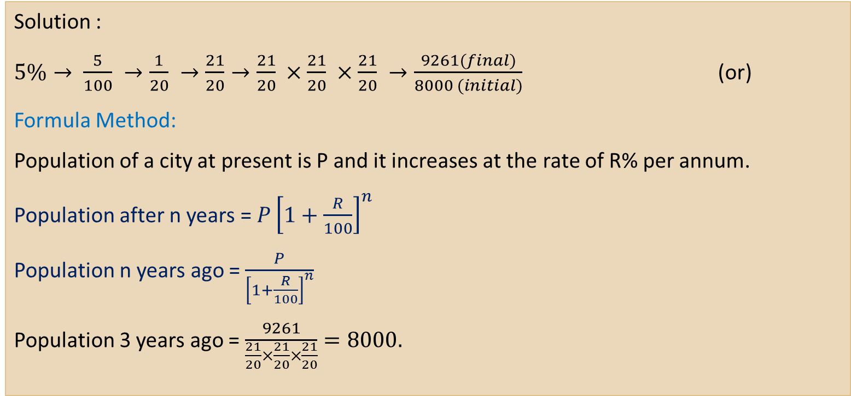
The population of a town increases by 5% every year. If the present population is 9261. The population 3 years ago was:
Solution :
$5\%→ \frac{5}{100} →\frac{1}{20} →\frac{21}{20}→\frac{21}{20} ×\frac{21}{20} ×\frac{21}{20} →\frac{9261(final)}{8000 (initial)}$ (or)
Formula Method:
Population of a city at present is P and it increases at the rate of R% per annum.
Population after n years = $P{\left[1+\frac{R}{100}\right]}^{n}$
Population n years ago = $\frac{P}{{\left[1+\frac{R}{100}\right]}^{n}}$
Population 3 years ago = $\frac{9261}{\frac{21}{20}×\frac{21}{20}×\frac{21}{20}}=8000.$

Slide 9


